Slide 1
Sales DashBoard
SAKSHAM ARORA
25TH APRIL,2025
POWER BI

Slide 2
OBJECTIVE
Design an interactive and visually appealing dashboard to track key business metrics like Sales, Units Sold, and Profit.
Provide business stakeholders with actionable insights using dynamic visuals, filters, and time-series analysis.

Slide 3
DATASET AND KPI’S
The dataset was sourced from Kaggle – a publicly available Sales and Profit dataset.
Key Columns used: Units sold , Profit ,Order Date, Segment, Product Name , Country , Sales.
Dataset spans unit sales data in year 2013 and 2014.
Important kpi’s included are total profit generated, total units sold and total sales generated in year 2013 -2014.

Slide 4
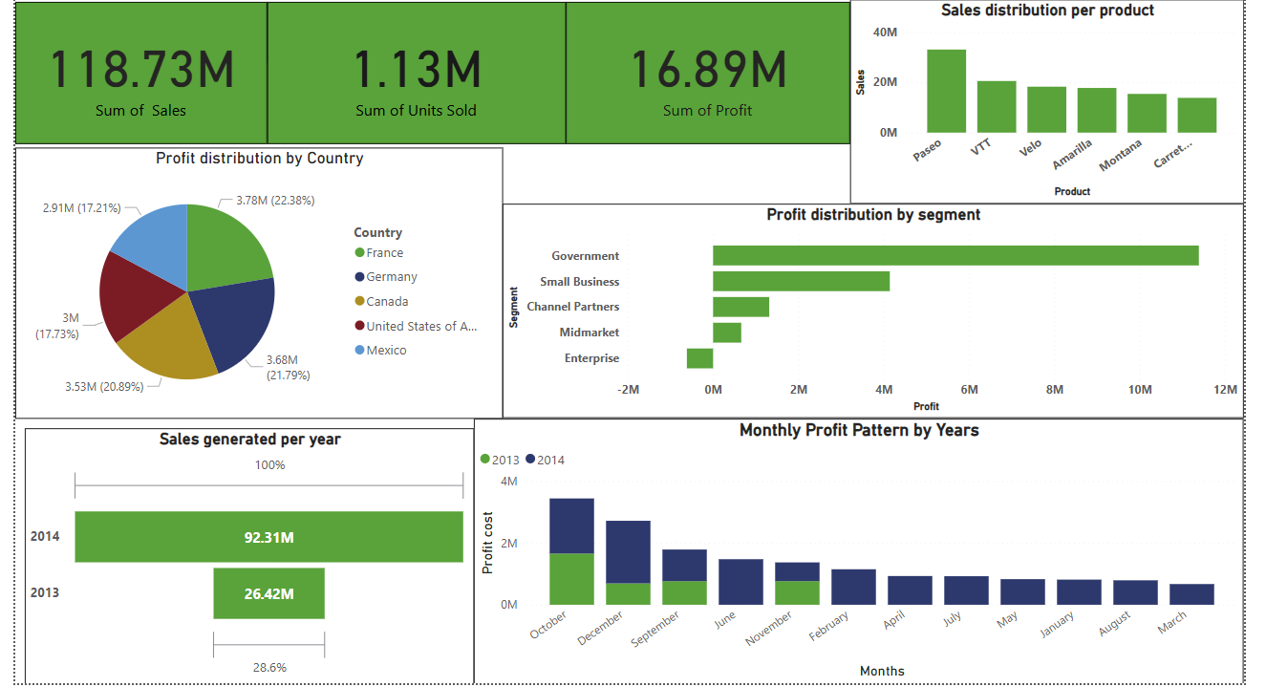

Slide 5
Key Business Insights
United States generated the highest profit among all countries, making it the most valuable market.
The Government segment outperformed other segments in profitability, indicating strong institutional demand.
Copiers stand out as the top product in terms of profit, suggesting it's a key product to focus on.
Overall Sales and Profit increased in 2014, showing strong year-over-year business growth.

Slide 6
Segments and Trends Analysis
Monthly profit pattern shows seasonality, with certain months consistently performing better than others considerably months in fourth quarter.
Monthly profit pattern shows seasonality, with certain months consistently performing better than Government.
Despite higher sales in some products, profitability varies, indicating cost differences or discounting.
Total Units Sold do not always align with highest profit, showing that volume ≠ profitability

Slide 7
Conclusions
1.Strengthen Institutional Partnerships: Given the Government segment’s strong profitability, invest in targeted marketing and tailored offerings for institutional clients to further capture this high-value market.
Optimize Product Portfolio: Focus on expanding the Copiers line—your top profit driver—while reviewing pricing and cost structures for lower-margin products to improve overall profitability.
Seasonal Inventory Planning: Use the identified monthly profit patterns to align inventory levels and promotional campaigns with peak months, ensuring you meet demand without overstocking in slower periods.

Slide 8
THANK YOU !!!!!!

